Slide 1
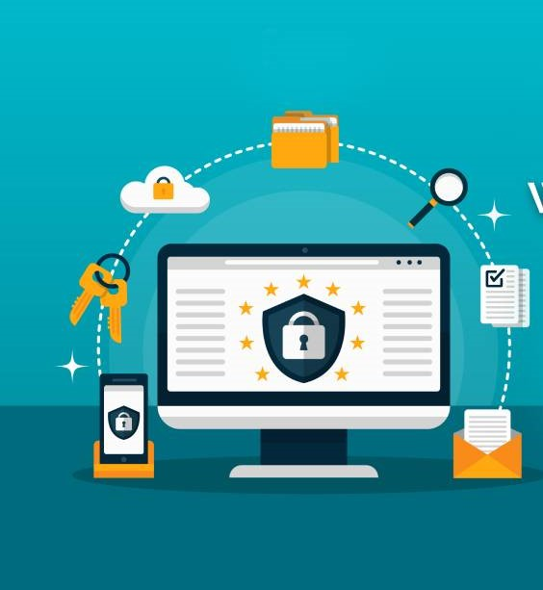
Web application Security
Submitted by- Submitted to -
Aryan Vani Mr. Gaurav Thulla

Slide 2
What Is Web Application Security?
Web application security is a central component of any web-based activity. The global nature of the Internet exposes web properties to attack from different locations and various levels of scale and complexity. Web application security deals specifically with the security surrounding websites, web applications and web services such as APIs.

Slide 3
What are common web app security vulnerabilities?
Attacks against web apps range from targeted database manipulation to large-scale network disruption. Let’s explore some of the common methods of attack or “vectors” commonly exploited.
Cross site scripting (XSS)
SQL injection (SQi)
Denial-of-service (DoS)
Data breach

Slide 4
Cross site scripting (XSS)
Cross-Site Scripting (XSS) attacks are a type of injection, in which malicious scripts are injected into otherwise benign and trusted websites. XSS attacks occur when an attacker uses a web application to send malicious code, generally in the form of a browser side script, to a different end user. Flaws that allow these attacks to succeed are quite widespread and occur anywhere a web application uses input from a user within the output it generates without validating or encoding it.
An attacker can use XSS to send a malicious script to an unsuspecting user. The end user’s browser has no way to know that the script should not be trusted, and will execute the script. Because it thinks the script came from a trusted source, the malicious script can access any cookies, session tokens, or other sensitive information retained by the browser and used with that site

Slide 5
How to prevent cross-site scripting
If possible, avoiding HTML in inputs - One very effective way to avoid persistent cross-site scripting attacks is to prevent users from posting HTML into form inputs.
Taking cookie security measures - Web applications can also set special rules for their cookie handling that can mitigate cookie-theft via cross-site scripting attacks. Cookies can be tied to particular IP addresses so that cross-site scripting attackers cannot access them.
Setting WAF rules - A WAF can also be configured to enforce rules which will prevent reflected cross-site scripting. These WAF rules employ strategies that will block strange requests to the server, including cross-site scripting attacks.

Slide 6
What is SQL injection (SQi)?
Structured Query Language (SQL*) Injection is a code injection technique used to modify or retrieve data from SQL databases. By inserting specialized SQL statements into an entry field, an attacker is able to execute commands that allow for the retrieval of data from the database, the destruction of sensitive data, or other manipulative behaviors.
With the proper SQL command execution, the unauthorized user is able to spoof the identity of a more privileged user, make themselves or others database administrators, tamper with existing data, modify transactions and balances, and retrieve and/or destroy all server data

Slide 7
How is a SQL Injection attack prevented?
Use of Prepared Statements (with Parameterized Queries) - This method of sanitizing database inputs involves forcing the developers to first define all the SQL code, and then to pass only specific parameters to the SQL query
Escape All User Supplied Input - When writing SQL, specific characters or words have particular meaning.
Use of Stored Procedures -By properly limiting the permissions of the database account running SQL queries, even non-robust application code that is vulnerable to SQL injection will lack the permissions necessary to manipulate unrelated database tables

Slide 8
Denial-of-Service (DoS) Attack
A denial-of-service (DoS) attack is a type of cyber attack in which a malicious actor aims to render a computer or other device unavailable to its intended users by interrupting the device's normal functioning. DoS attacks typically function by overwhelming or flooding a targeted machine with requests until normal traffic is unable to be processed, resulting in denial-of-service to addition users. A DoS attack is characterized by using a single computer to launch the attack.
The primary focus of a DoS attack is to oversaturate the capacity of a targeted machine, resulting in denial-of-service to additional requests. The multiple attack vectors of DoS attacks can be grouped by their similarities.

Slide 9
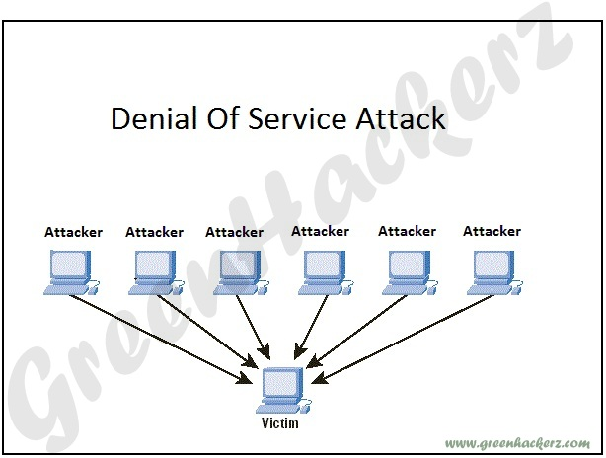

Slide 10
Denial-of-Service attack prevention
Deploy an antivirus program and firewall into your network if not already done. This helps in restricting the bandwidth usage to authenticated users only.
Server configuration can help diminish the probability of being attacked. If you’re a network administrator at some firm, take a look at your network configurations and harden the firewall policies to block out unauthenticated users from addressing the server’s resources.
Some third-party services offer guidance and protection against DoS attacks. These can be expensive but effective as well. If you have the capital to deploy such services in your network, better get going.

Slide 11
Data Breach
A data breach is the release of confidential, private, or otherwise sensitive information into an unsecured environment. A data breach can occur accidentally, or as the result of a deliberate attack.
Millions of people are affected by data breaches every year, and they can range in scope from a doctor accidentally looking at the wrong patient’s chart, to a team of elite agents cracking government computers to uncover military secrets.
Data breaches are a major concern for cyber-security because sensitive data is constantly being transmitted over the Internet. This continuous transfer of information makes it possible for attackers in any location to attempt data breaches on almost any person or business they choose.

Slide 12
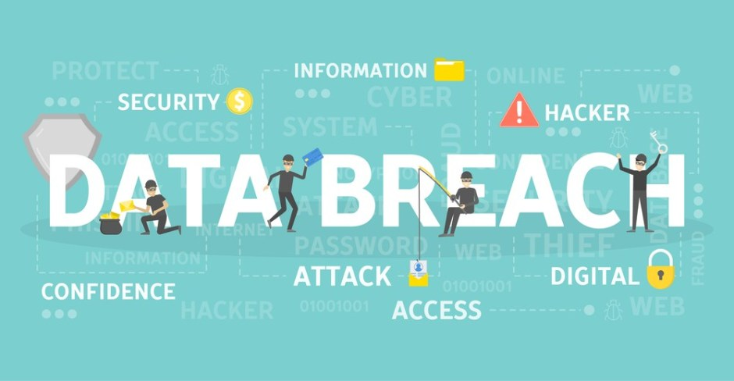

Slide 13
Common examples of a data breach
Lost or stolen credentials - The simplest way to view private data online is by using someone else’s login credentials to sign into a service.
Social engineering attacks - Social engineering involves using psychological manipulation to trick people into handing over sensitive information.
Insider Threats - These involve people who have access to protected information deliberately exposing that data, often for personal gain.

Slide 14
How can data breaches be prevented?
Practices such as not using credit cards with suspicious vendors and choosing long, unique passwords for online services will stop some of the easiest and most common data breach attacks. Keeping software up to date with security patches and using security software such as antivirus and malware blockers will also help mitigate data breaches.
Users can help combat data breaches by ensuring that their employees only have the minimum amount of access and permissions necessary to do their jobs. It is also a good idea for a company or institute to prepare a response plan to be executed in the case of a data breach, with a goal of minimizing or containing the leak of information.

Slide 15
Essential cyber security measures
Use strong passwords Strong passwords are vital to good online security
Control access Make sure that individuals can only access data and services for which they are authorised.
Put up a firewall Firewalls are effectively gatekeepers between your computer and the internet, and one of the major barriers to prevent the spread of cyber threats such as viruses and malware.
Use security software You should use security software, such as anti-spyware, anti-malware and anti-virus programs, to help detect and remove malicious code if it slips into your network.

Slide 16
Thank you

